Slide 1

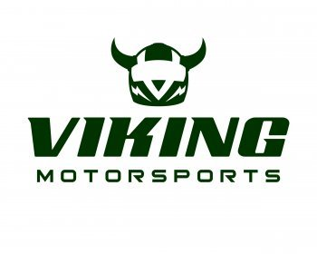
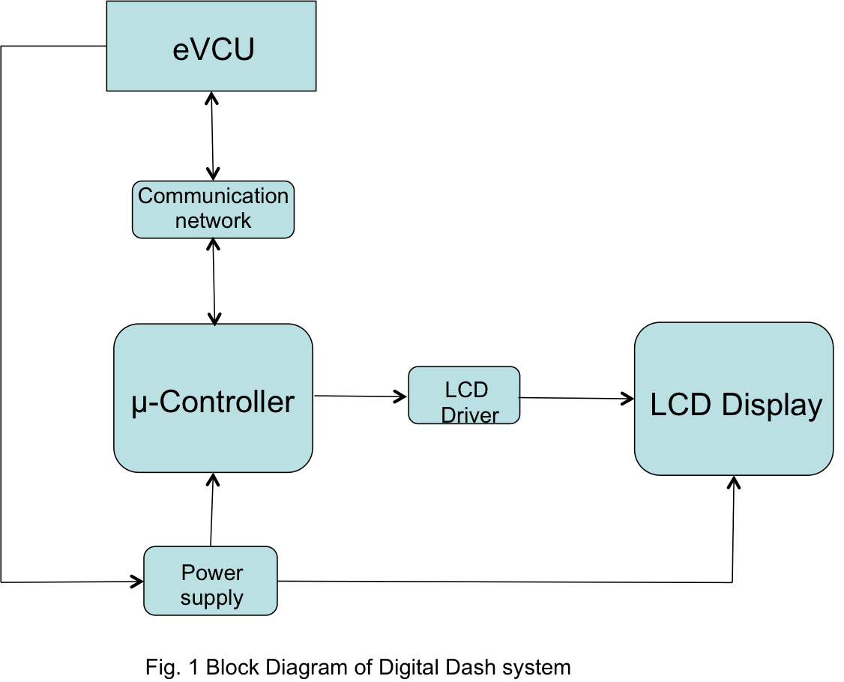


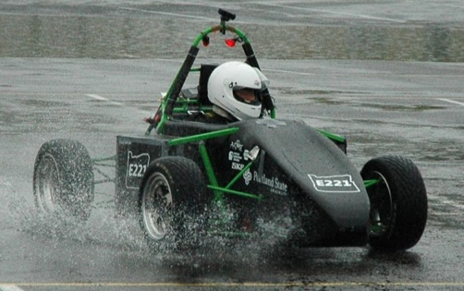
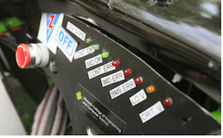
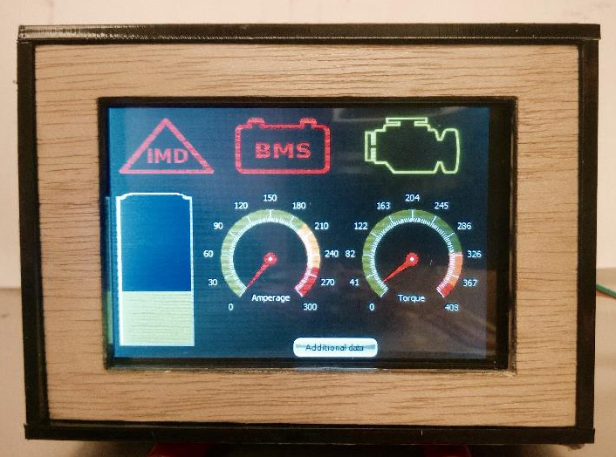
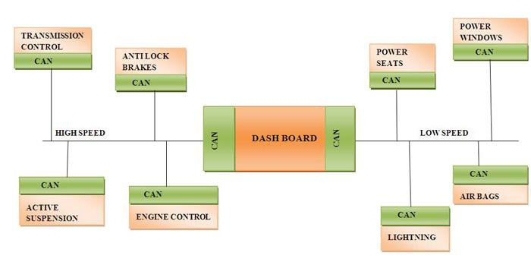
Digital Dashboard for Formula SAE Electric Racecar
Capstone Team: Noah Erickson, Chad Thueson, Rishal Dass, Jaime Rodriguez, Sean Koppenhafer
Project Sponsor: Michal Podhradsky – Viking Motorsports Team
Capstone Advisor: Dr. Christof Teuscher – Portland State University ECE Department
Abstract
Implementation
Software
The Viking Motorsports Electrical Vehicle (Figure 1) uses an array of LEDs to indicate problems with mission critical systems. (Figure 2) The increased complexity that high voltage systems introduce into a racecar require increased diagnostics to keep the car running safely and correctly. The driver must have the status of all important subsystems visible to clearly see and determine the vital faults, so they can adjust their driving style as necessary. With an updated dash system detailed information can be displayed in real time from the vehicle control unit. The driver can be kept up to date on system functionality both on track or in the pits.
The solution to display all this critical information is a small 3.5” LCD screen that will receive information from the subsystems of the vehicle and display them in a simple Graphical User Interface. The interface will not only display the warnings and faults like the old LED implementation but will also display useful real time information such as motor torque, battery level and amperage draw of the motor.
The software for the Digital Dashboard was written in the Arduino IDE using the C programming language. In order to interface with the vehicles CAN networks and the 4D systems screen, two libraries provided by the respective distributers were used. The software receives data from the vehicles CAN networks by looking for pertinent messages. Then the messages are interpreted and sent to the screen.
CAN Network
Figure 4: Digital Dash Block Diagram
Testing
Hardware
LCD Mating
Header
For half of the development cycle we were able to use last years car as a test platform. During this time we were able to determine that messages from one of the two CAN networks were successfully being received and interpreted.
In the second half of the development cycle we did not have access to a functioning test vehicle. To determine if the digital dashboard worked, we developed a demo program to send out simulated messages that behaved similarly to the vehicles subsystems.
CAN Inputs
LCD DISPLAY
A custom PCB was fabricated to fit in the limited space allocated for the dash in the vehicle. The layout of the board was designed so the control pins of the LCD would connect directly with the header affixed on the board. Our board was created by modifying the existing Arduino Due design. (Figure 5)
System
Micro Controller
CAN
Network
eVCU
Simulator
Figure 1: VMS SAE Electric Vehicle
Figure 2: Current Dash of Electric Vehicle
Data Input
Controller
Programming Circuit
12V Supply
Figure 5: Custom PCB
Figure 7: Block Diagram for Demo System
Introduction to CAN
The Controller Area Network (CAN) bus is one of several central networking protocols that are used in the automotive industry. Implementing the CAN protocol allows the vehicles subsystems to communicate between each other.
The 3.5” screen is touch enabled. It gives us the capability to navigate through multiple screens by way of on screen buttons to view data from different systems. This allows the user to view more detailed information about the vehicles’ respective subsystems. The screen layout was kept as simple as possible to allow the driver to quickly glance at the screen and interpret the data.(Figure 6)
Conclusion
The digital dashboard performs as intended when simulated with the demo program that we created. Instead of testing all functionally of the screen, the demo program focuses on only the most important functions.
Due to circumstances outside of our control, the digital dashboard has not been officially tested on the electric vehicle but we are confident that it would function correctly.
Figure 6: LCD Displaying Main Screen
Figure 3: CAN Network Example
Acknowledgements: Michal Podhradsky, Dr. Christof Teuscher, Quinn Sullivan and the entire Viking Motorsports Team
Notes:
1

